Slide 1
Cloud Automation
Precomputing Roadmaps for Flexible Manipulation
Manikanta Maddula (12)
Dig Vijay Kumar Yarlagadda (26)

Slide 2
synergistic robot–cloud architecture
The focus is on the use of cloud computing for efficiently planning the motion of new robot manipulators designed for flexible manufacturing floors.
synergistic robot–cloud architecture - an architecture that splits computation between the remote cloud and the robot appears advantageous

Slide 3
Traditional automation
systems execute repetitive tasks with high efficiency and accuracy without the need for significant computation
cost-effective only for large-scale industrial settings where similar products are assembled for long periods of time
The future of automation lies in flexible factory floors and quick burst manufacturing processes, which can provide complex, short-life-cycle products fast.
Future small-scale, flexible automation facilities will depend on effective computational solutions, both at a system and an algorithmic level

Slide 4
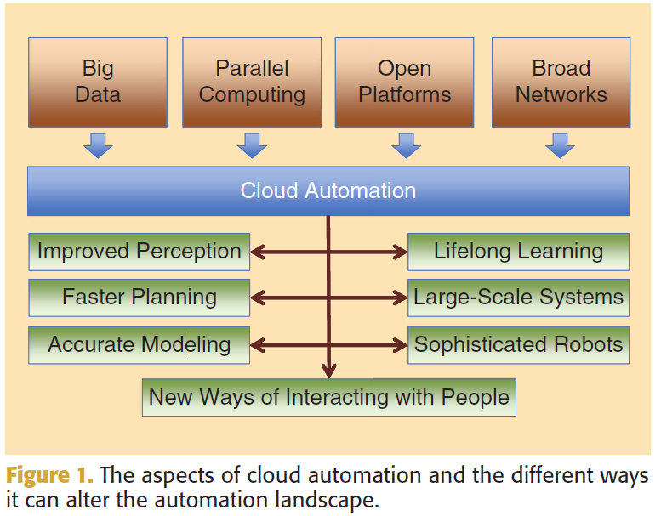
Emerging Opportunities in Cloud Automation

Slide 5
Emerging Opportunities in Cloud Automation
Improved Perception and World Knowledge
- Feeding data from rich sensors, quick identification of perceived objects, allows access to metadata
Fast Resolution of Planning Challenges
More Accurate Models
Opportunities for Lifelong Learning
Highly Networked Large-Scale Systems
Computing for Sophisticated Robots
New Ways to Interact with People

Slide 6
Schemes for Cloud-Based Planning
Key automation operations that can greatly benefit from the use of cloud computing include motion planning and manipulation
Local-Only Computation
- planner running locally on the robot
- without any external interaction, computes a manipulation path on the fly

Slide 7
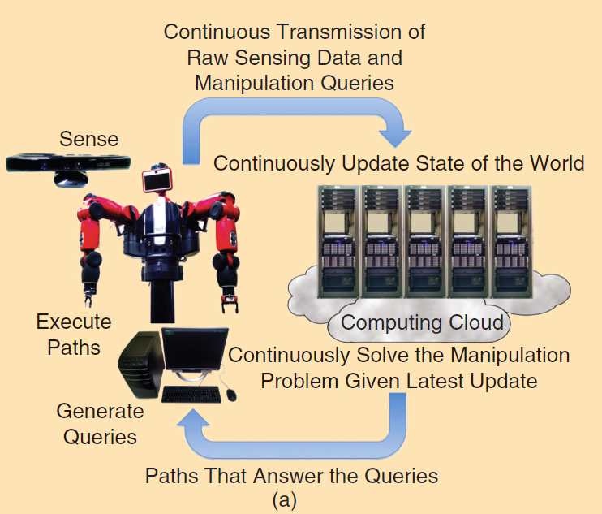
Cloud-Only Computation

Slide 8
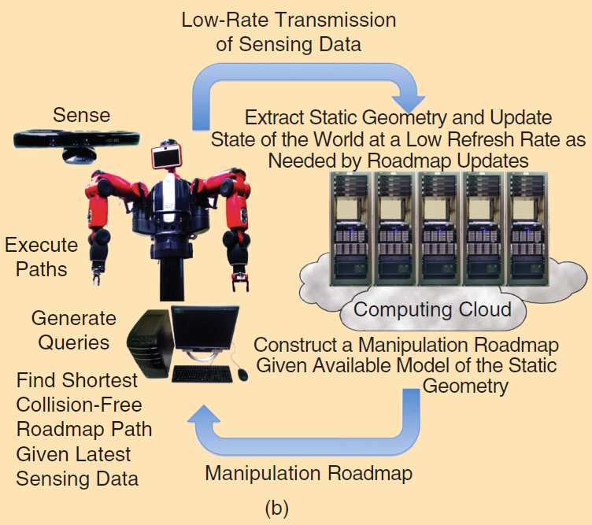
Synergistic Robot–Cloud Computation

Slide 9
Synergistic Robot–Cloud Computation
An effective implementation of the synergistic model should aim to achieve the following:
Computational efficiency
Communication overhead
Safety and reactivity to changes
Path quality

Slide 10
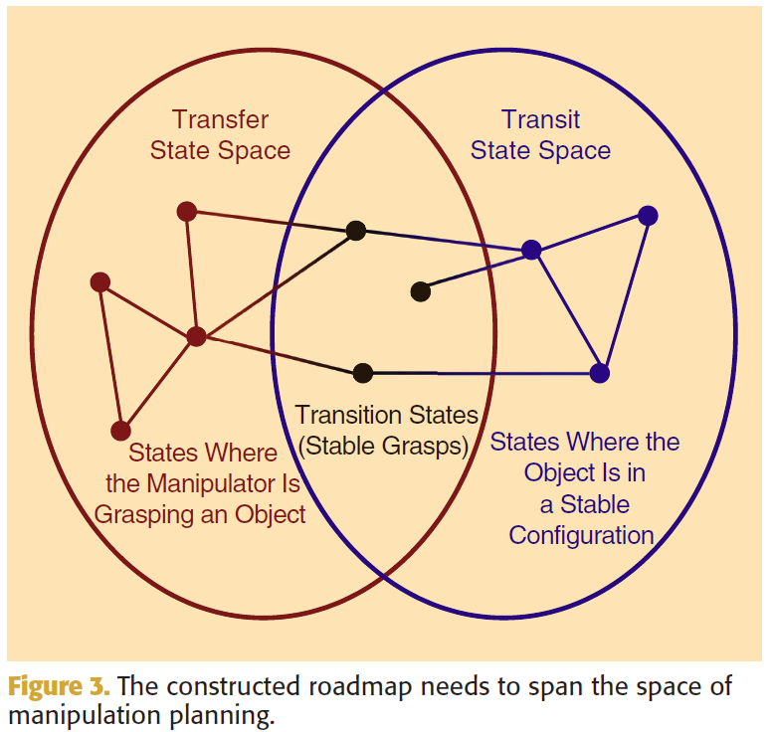
Planning Using Roadmap Precomputation
Computing a Manipulation Roadmap

Slide 11
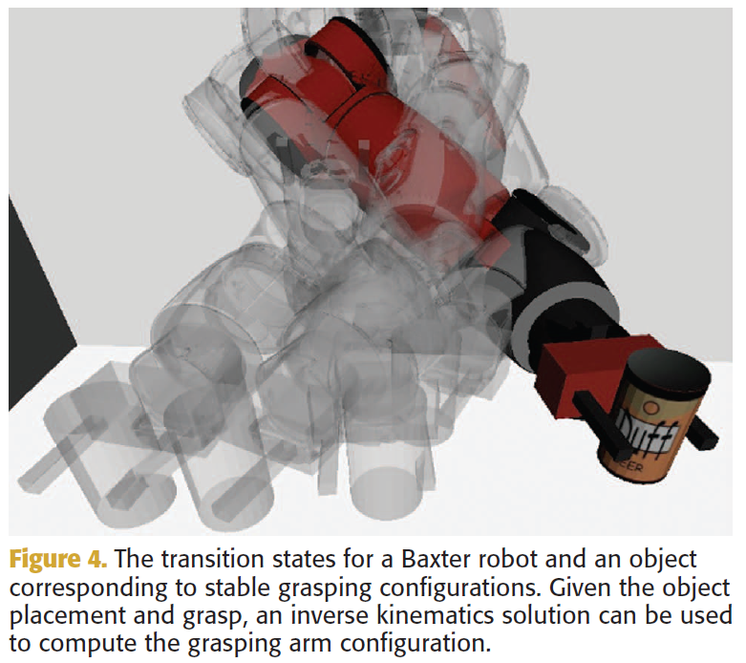
Planning Using Roadmap Precomputation
Computing a Manipulation Roadmap

Slide 12
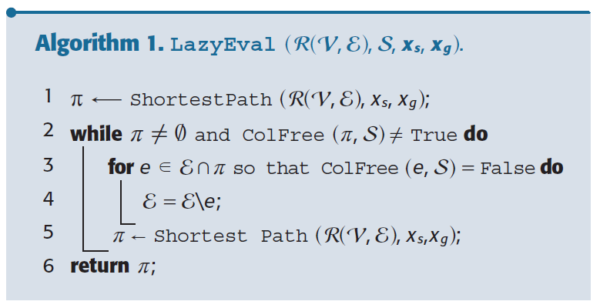
Planning Using Roadmap Precomputation
Using a Precomputed Roadmap

Slide 13
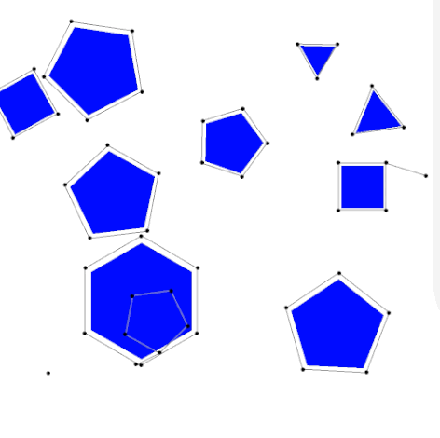
Effect of Roadmap properties on Cloud-Based Schemes
Probabilistic Roadmap (PRM) is a motion planning algorithm in robotics, which solves the problem of determining a path between a starting configuration of the robot and a goal configuration while avoiding collisions.
Large, dense roadmaps are beneficial but tradeoff has to be achieved between query resolution time and path quality.

Slide 14
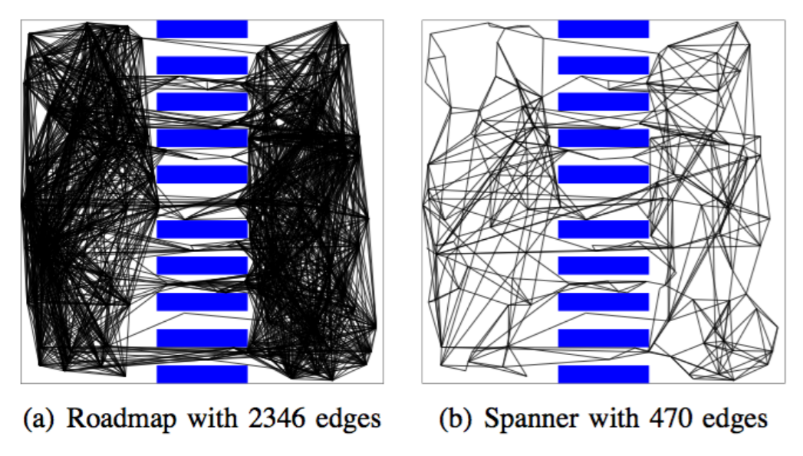
Roadmap spanners
A fully connected graph gives asymptotically optimal solutions – resembles exhaustive search, but results quickly emerge into a huge data structure.
If we attempt to connect any new sample with approximately k=log(n) neighbors, where n is the number of nodes in the roadmap, we can obtain asymptotically optimal roadmap. (PRM*)
A t-spanner is a subgraph of a graph, where the paths between all pairs of vertices are dilated by a factor of t relative to paths on the original graph, where t is the stretch factor of the spanner.
For every shortest path in the original graph − there is a path in the spanner that is no longer than t times the original length.
http://moveit.ros.org/assets/pdfs/2013/icra2013tutorial/spanner_roadmaps_Bekris.pdf

Slide 15
Incremental Roadmap Scanner (IRS)
IRS returns a roadmap that has the same set of vertices as PRM) but only a subset of its edges.
IRS is guaranteed to return a solution path to a motion-planning query that is at most t times longer than the solution returned by PRM) with the same set of vertices, where the stretch factor t is an input parameter.
IRS provides orders of magnitude sparser data structures, allows faster refresh rate of roadmap by providing sensing updates.

Slide 16
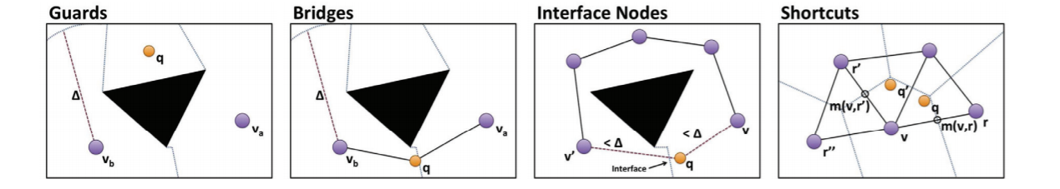
Sparse Roadmap Scanner (SPARS)
In continuous spaces, an individual configuration can be used to represent its local region, and no neighboring samples need to be added as new nodes in the roadmap if they are not necessary for completeness or path quality purposes.
Nodes are added only if they are necessary for coverage, connectivity and optimality.
The four types of configuration-space samples q that sparse roadmap spanners are considering for addition. Nodes may be added for coverage (guards), connectivity (bridges), or to connect nodes which share an “interface” (interface nodes), or to satisfy near-optimality constraints when efficient C-space paths (q to q ) are found (shortcuts).
Dobson, Andrew, and Kostas E. Bekris. "Sparse roadmap spanners for asymptotically near-optimal motion planning." The International Journal of Robotics Research 33.1 (2014): 18-47.

Slide 17
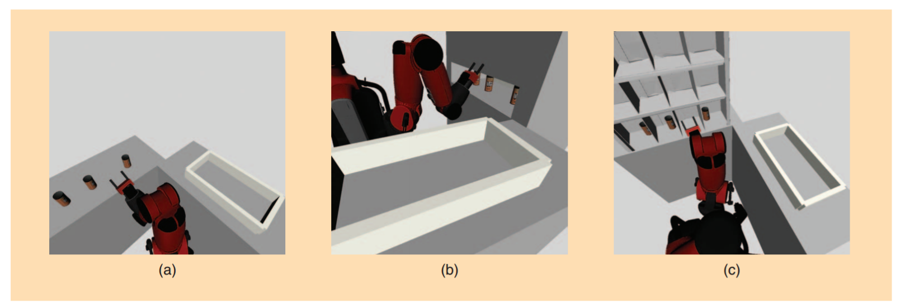
Evaluation of methods
A Baxter arm is used to evaluate PRM*, IRS and SPARS in terms of computational efficiency, path quality and success ratio for a changing scene.
The three versions of the environment used for evaluating the methods, inspired by the Amazon Picking Challenge: (a) easy, (b) medium, and (c) hard.
The offline roadmaps are computed given the easy environment. This problem involves a Baxter arm grasping an object from the tabletop in a vertical configuration and placing it inside a box in a horizontal configuration.

Slide 18
Evaluation of methods (Cont.)
The medium challenge has the objects placed on a shelf that was not known during the construction of the roadmap and limits the motion of the robot.
The hard challenge has multiple shelves, with the objects placed further back than in the medium challenge, which further limits the capability of the arm to grasp the items.

Slide 19
Evaluation of methods (Cont.)
Each pick-and-place manipulation problem is split into three sub problems:
A transit plan from an initial configuration of the arm to a grasping configuration of the movable object on the horizontal surface,
A transfer plan between the reachable grasping configuration of the initial object location to a grasping configuration at the goal, and
A transit plan from the grasping configuration at the goal to the safe initial arm configuration.
Each iteration corresponds to an attempt to add both a transit and a transfer node to the roadmap.
PRM* roadmap 20,000 nodes and 800,000 edges after 10,000 iterations.

Slide 20
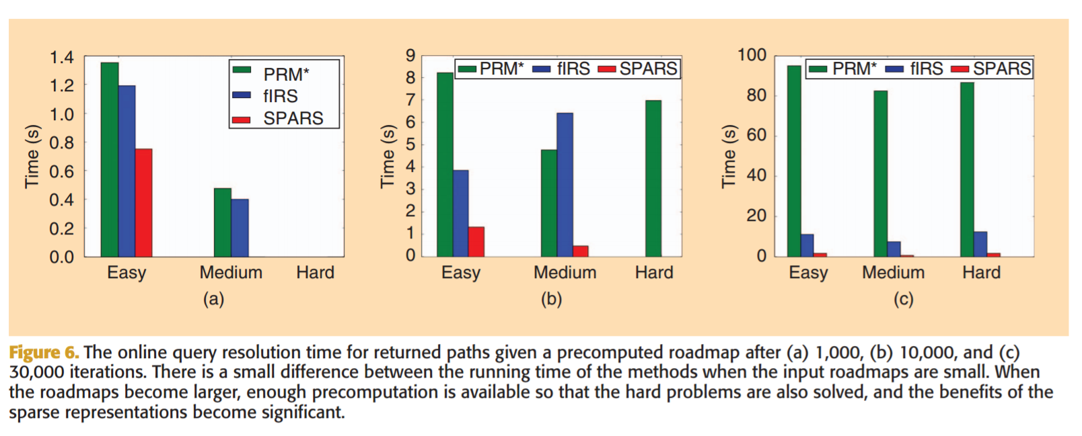
Evaluation - Query resolution time

Slide 21
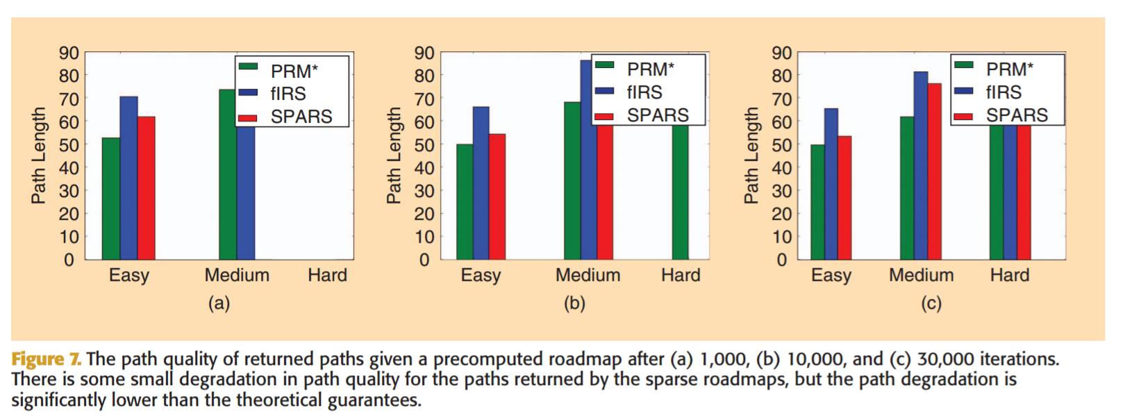
Evaluation - Path quality

Slide 22
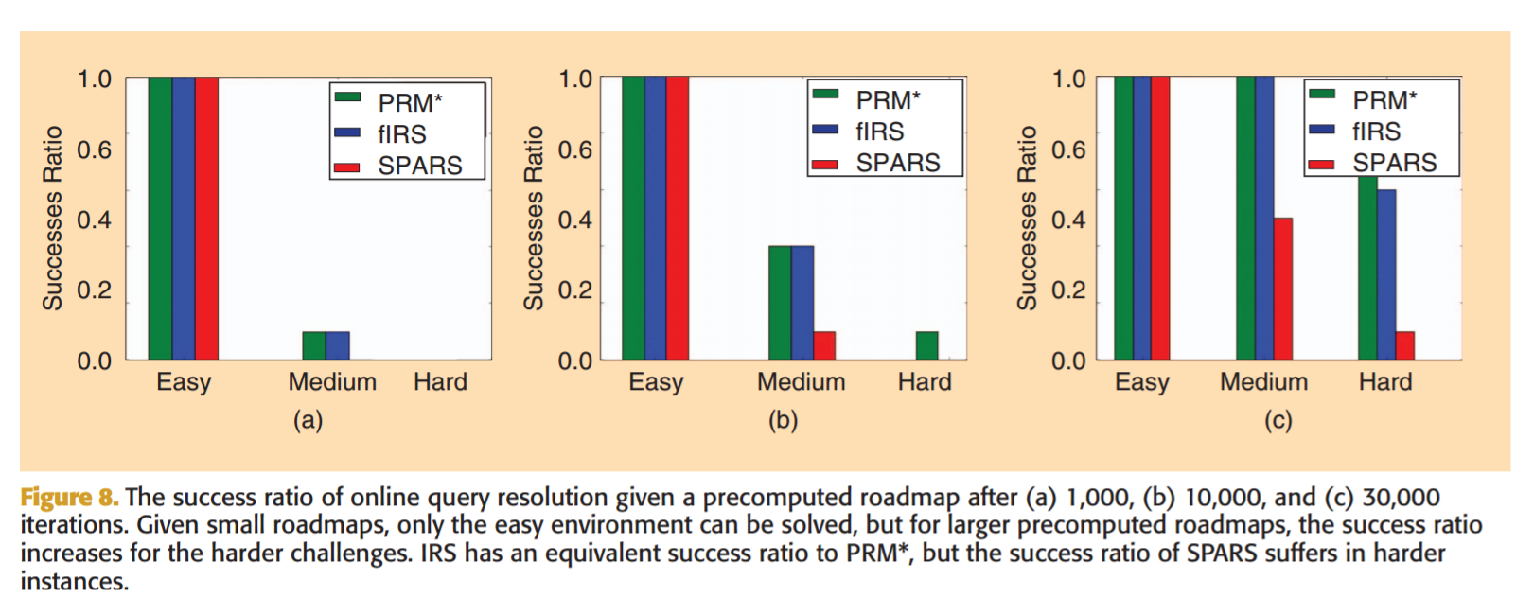
Evaluation – Success ratio

Slide 23
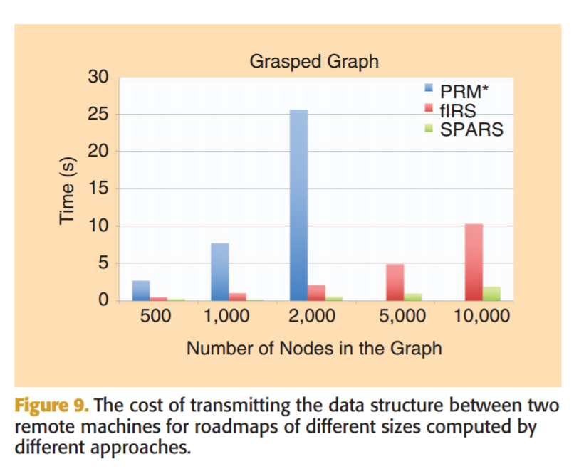
Evaluation – Communication overhead

Slide 24
Conclusion
Near-optimal roadmaps decrease the cost of communication and result in faster query resolution.
For the sparsest alternative, which results in the fastest query resolution, there is also degradation in success ratio.
The PRM and IRS methods exhibit similar success ratio across the different environments. The success ratio of the SPARS method, however, suffers in the harder environments.
A fast IRS iteration is typically faster than a PRM* one, and this results in a reduced construction time for IRS. SPARS introduces a small computational overhead for reasoning about which edges and vertices to retain, but it is still in the order of PRM* as it benefits from the sparsity of the computed data structure.
There are proven benefits of investing computational power to compute roadmap data structures on the cloud, which are then used to answer motion-planning queries on the robot’s local workstation given an updated model of its surroundings.

Slide 25
References
Bekris, Kostas, et al. "Cloud automation: Precomputing roadmaps for flexible manipulation." IEEE Robotics & Automation Magazine 22.2 (2015): 41-50.
https://en.wikipedia.org/wiki/Probabilistic_roadmap
Dobson, Andrew, and Kostas E. Bekris. "Sparse roadmap spanners for asymptotically near-optimal motion planning." The International Journal of Robotics Research 33.1 (2014): 18-47.

Slide 26
Thank You !!!

